Slide 1
PatSets User Manual

Slide 2
PatSets All Generator
Purpose
To generate PatSets All sheet by tool
Notes:
Purpose
To generate Pattern set all sheet
Lab context

Slide 3
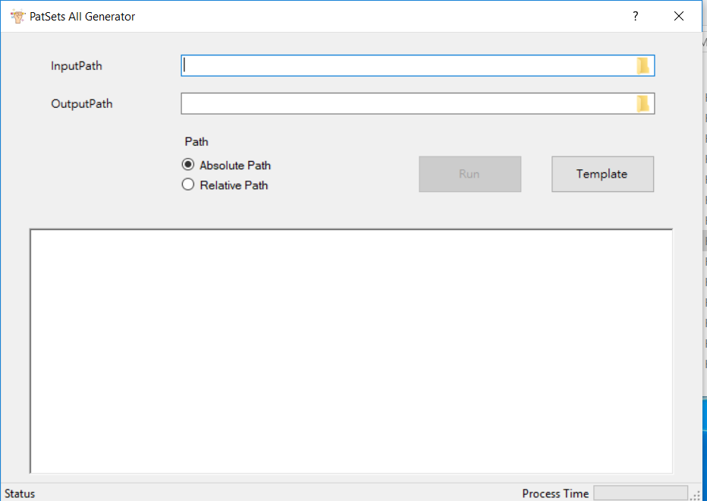
Introduction
Help
1.Enter input path
2.Enter output path
3.Select absolute path or relative path
Template example
4.Execution
Information Field

